Slide 1
CAR PRICE PREDICTION
By:
POOJASHREE d S

Slide 2
Content:
Problem statement
Data pre-processing
Visualization
Model development and evaluation
Conclusions

Slide 3
Problem statement:
The main aim of the project is to predict the price of the used car available in the various website. Due to the Covid 19 we have seen lot of changes in the market.
With the covid 19 impact in the market, we have seen lot of changes in the car market. Now some cars are in demand hence making them costly and some are not in demand hence cheaper. One of our clients works with small traders, who sell used cars. With the change in market due to covid 19 impact, our client is facing problems with their previous car price valuation machine learning models. So, they are looking for new machine learning models from new data. We have to make car price valuation model..

Slide 4
Data pre -processing
The data set consists of about SIX thousand entries with seven feature column and one target column - Price.
The counts of different classes of target are obtained by .value_counts() method.
we remove the row contain nan values associated with it using dropna.
.

Slide 5
Rare and common words in the text data are generated to get a general idea of the review emotion. Common words are generated with the help of Counter().
Some of the common words are- product, good, quality, nice, battery and sound. Some of the rare words are – compitable, keyboard, existed and prolific.
Emojis are useful in detecting the mindset of the consumers, emot library is used to convert emojis to their respective emotion-word. A function convert_emojis is defined for this purpose.
Tokenization is performed and the length of the text is computed in a new column.
We use Tfidf vectorizer to achieve vectorization.

Slide 6
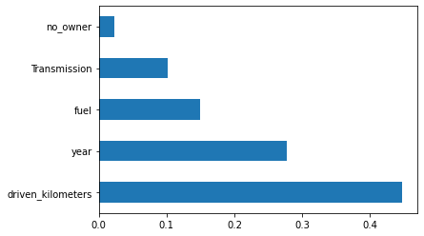
Visualizations:
The above graph shows that driven kilometer of the car effect more on the price and the year of manufacture also effect the price of the car

Slide 7
Model development and evaluation:
Sklearn is used for pre-processing and model building steps. All algorithms for processing are imported. Sklearn.metrics will provide the needed evaluation metrics such as accuracy score, classification report and confusion matrix.
Random Forest Regressor gives better accuracy than oher two regressor.

Slide 8
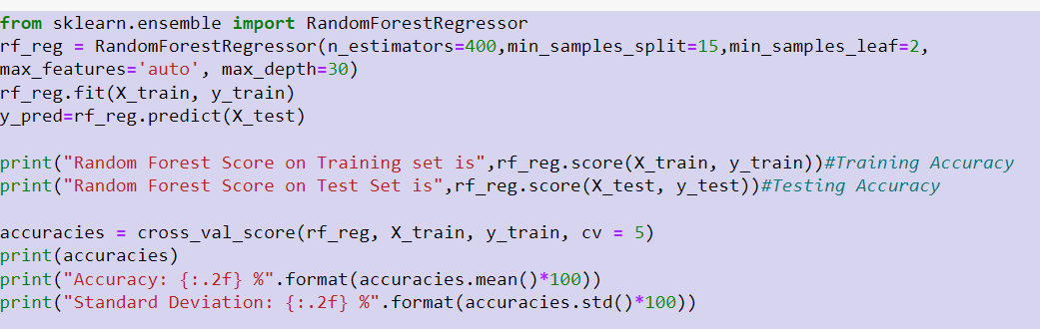
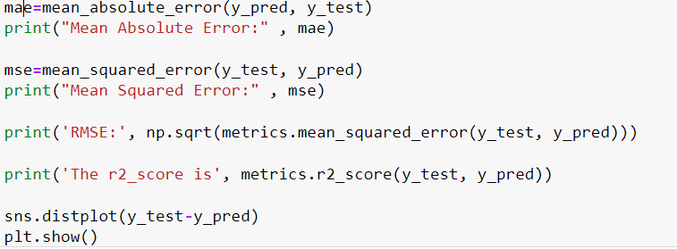

Slide 9
Conclusions:
The aim of our problem was to successfully predict the price of used car
The dataset is obtained by scraping data off Olx and car24 using Selenium. The length of a review does not influence the nature or the star category of a rating.
It is regression kind of sample using the Random forest regressor which gives better acuuracy able to predict the price.

